Slide 1
ARRAYS AND ARRAY OF OBJECTS
Prepared By: Dimple Bohra

Slide 2
Java Arrays
Arrays are used to store multiple values in a single variable, instead of declaring separate variables for each value.
There are two types of array:
Single Dimensional Array
Multidimensional Array

Slide 3
Single Dimensional Array in Java
Syntax to Declare an Array in Java
dataType[] arr; (or)
dataType []arr; (or)
dataType arr[];

Slide 4
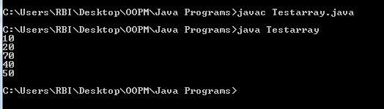
Instantiation of an Array in Java
//Java Program to illustrate how to declare, instantiate, initialize
//and traverse the Java array.
class Testarray
{
public static void main(String args[])
{
int a[]=new int[5]; //declaration and instantiation
a[0]=10; //initialization
a[1]=20;
a[2]=70;
a[3]=40;
a[4]=50;
//traversing array
for(int i=0;i<a.length;i++) //length is the property of array
System.out.println(a[i]);
}
}
declaration, instantiation
//and initialization of Java array in a single line
int a[]={10,20,70,40,50};

Slide 5
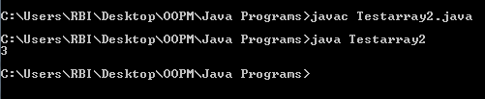
Passing Array to a Method in Java
//Java Program to demonstrate the way of passing an array
//to method.
class Testarray2
{
//creating a method which receives an array as a parameter
static void min(int arr[])
{
int min=arr[0];
for(int i=1;i<arr.length;i++)
if(min>arr[i])
min=arr[i];
System.out.println(min);
}
public static void main(String args[])
{
int a[]={33,3,4,5};//declaring and initializing an array
min(a);//passing array to method
}
}
Notes:
We can pass the java array to method so that we can reuse the same logic on any array.

Slide 6
Multidimensional Array in Java
In such case, data is stored in row and column based index (also known as matrix form).
Syntax to Declare Multidimensional Array in Java
dataType[][] arrayRefVar; (or)
dataType [][]arrayRefVar; (or)
dataType arrayRefVar[][];
Example to instantiate Multidimensional Array in Java
int[][] arr=new int[3][3];

Slide 7
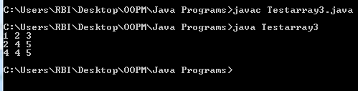
//Java Program to illustrate the use of multidimensional array
class Testarray3
{
public static void main(String args[])
{
//declaring and initializing 2D array
int arr[][]={{1,2,3},{2,4,5},{4,4,5}};
//printing 2D array
for(int i=0;i<3;i++)
{
for(int j=0;j<3;j++)
{
System.out.print(arr[i][j]+" ");
}
System.out.println();
}
}
}

Slide 8
Array of objects
JAVA ARRAY OF OBJECT, as defined by its name, stores an array of objects. Unlike a traditional array that store values like string, integer, Boolean, etc an array of objects stores OBJECTS. The array elements store the location of the reference variables of the object.
Syntax:
Class obj[]= new Class[array_length]

Slide 9
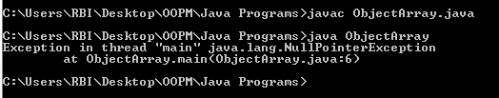
class ObjectArray{
public static void main(String args[]){
Account obj[] = new Account[2] ;
//obj[0] = new Account();
//obj[1] = new Account();
obj[0].setData(1,2);
obj[1].setData(3,4);
System.out.println("For Array Element 0");
obj[0].showData();
System.out.println("For Array Element 1");
obj[1].showData();
}
}
class Account{
int a;
int b;
public void setData(int c,int d){
a=c;
b=d;
}
public void showData(){
System.out.println("Value of a ="+a);
System.out.println("Value of b ="+b);
}
}

Slide 10
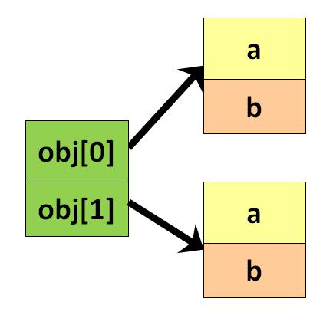
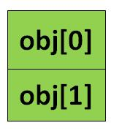
Account obj[] = new Account[2];
Account obj[] = new Account[2] ;
obj[0] = new Account();
obj[1] = new Account();
Notes:
Account obj[] = new Account[2]; exactly creates an array of two reference variables as obj[0] and obj[1]

Slide 11
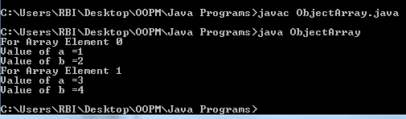
class ObjectArray{
public static void main(String args[]){
Account obj[] = new Account[2] ;
obj[0] = new Account();
obj[1] = new Account();
obj[0].setData(1,2);
obj[1].setData(3,4);
System.out.println("For Array Element 0");
obj[0].showData();
System.out.println("For Array Element 1");
obj[1].showData();
}
}
class Account{
int a;
int b;
public void setData(int c,int d){
a=c;
b=d;
}
public void showData(){
System.out.println("Value of a ="+a);
System.out.println("Value of b ="+b);
}
}

Slide 12
Home work: Debug this code
import java.util.*;
import java.io.*;
class greatest1
{ Scanner sc = new Scanner(System.in);
void get_data(int n)
{
int a[]= new int [n];
for(int i =0;i<n;i++)
{
System.out.println("Enter element at position "+i);
a[i]=sc.nextInt();
}
}
void greatest_num(int n)
{
int a[]= new int [n];
int greatest=a[0];
for(int j=0;j<n;j++)
{
{ if (a[j]>greatest)
greatest = a[j];
}
}
System.out.println("The greatest no is : "+greatest);
}
}
class calc_greatest
{ public static void main(String args[])
{
Scanner sc = new Scanner(System.in);
System.out.println("Enter value of n");
int c = sc.nextInt();
greatest1 g = new greatest1();
g.get_data(c);
g.greatest_num(c);
} }

Slide 13


